Slide 1
Stanford ME469: Introduction to the low-Mach Number Approximation
Stefan P. Domino
Computational Thermal and Fluid Mechanics
Sandia National Laboratories SAND2018-4536 PE

Slide 2
Introduction to the low-Mach Number Approximation: Outline
Variable density, non-isothermal equation set
DOF vs Equation count
Non-dimensional form
Asymptotic Expansion
Derived low-Mach Equation Set
The Role of Pressure
Motion and Thermodynamic
Conclusions

Slide 3
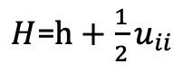
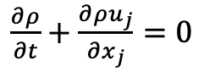
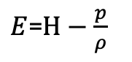
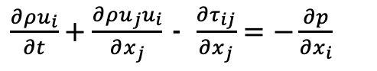
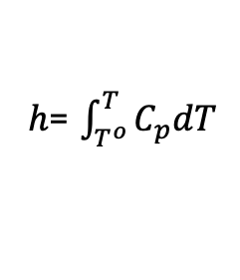
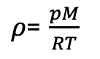
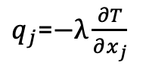
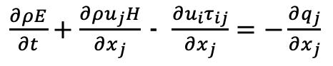
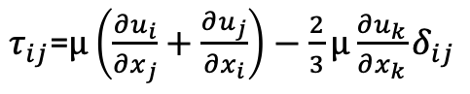
Consider a Variable Density, non-Isothermal Fluid Flow System
Consider the variable density (non-isothermal) equations of motion (momentum and continuity) with energy transport
See Paolucci (1982) or Baum (1978) for the low-Mach pedigree
Number of Equations = (3+nDim) = Number of unknowns
DOF: (3 + nDim)
Density, ρ (1)
Pressure, p (2)
Velocity, u_{i} (nDim)
Total energy, E (3)
Total enthalpy, H
Static enthalpy, h
Temperature, T
Properties:
Viscosity, μ
Specific heat, C_{p}
Thermal conductivity, λ
Constitutive Relationships
Ideal gas law (1)
Newtonian stress, τ_{ij}
Heat flux vector, q
Total enthalpy, H
Static enthalpy, h
dh/dT = Cp
$\frac{∂ρ}{∂t}+\frac{∂{ρu}_{j}}{∂x_{j}}$ $=0$
$\frac{∂ρu_{i}}{∂t}+\frac{∂ρu_{j}u_{i}}{∂x_{j}}$ - $\frac{∂τ_{ij}}{∂x_{j}}=−\frac{∂p}{∂x_{i}}$
(2+nDim)
$\frac{∂ρE}{∂t}+\frac{∂ρu_{j}H}{∂x_{j}}$ - $\frac{∂u_{i}τ_{ij}}{∂x_{j}}=−\frac{∂q_{j}}{∂x_{j}}$
+1 EOS
$ρ$= $\frac{pM}{RT}$
$τ_{ij}$=$μ\left(\frac{∂u_{i}}{∂x_{j}}+\frac{∂u_{j}}{∂x_{i}}\right)−\frac{2}{3}μ\frac{∂u_{k}}{∂x_{k}}δ_{ij}$
$q_{j}$=$−λ\frac{∂T}{∂x_{j}}$
(3+nDim)
$E$=$H−\frac{p}{ρ}$
$H$=$h+\frac{1}{2}u_{ii}$
$h$= $\int_{T^{o}}^{T}{C_{p}dT}$

Slide 4
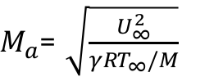
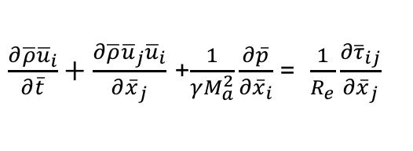
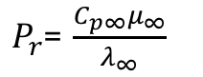
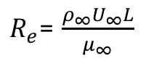
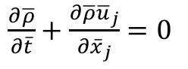
Dimensionless Form
Nondimensionalization is via a characteristic velocity and length scale
Note, as the Mach number approaches zero, the viscous work and kinetic energy terms become negligible
However, the momentum equation notes a singular due to the pressure gradient term
Conclusions: In the limit of zero Mach number, the momentum equation is not well defined and, in fact, singular
$\frac{∂\overline{ρ}}{∂\overline{t}}+\frac{∂\overline{ρ}{\overline{u}}_{j}}{∂{\overline{x}}_{j}}$ $=0$
$\frac{∂\overline{ρ}{\overline{u}}_{i}}{∂\overline{t}}+\frac{∂\overline{ρ}{\overline{u}}_{j}{\overline{u}}_{i}}{∂{\overline{x}}_{j}}$ +$\frac{1}{γM_{a}^{2}}\frac{∂\overline{p}}{∂{\overline{x}}_{i}}$= $\frac{1}{R_{e}}\frac{∂{\overline{τ}}_{ij}}{∂{\overline{x}}_{j}}$
$\frac{∂\overline{ρ}\overline{h}}{∂\overline{t}}+\frac{∂\overline{ρ}{\overline{u}}_{j}\overline{h}}{∂{\overline{x}}_{j}}$ = $−\frac{1}{{P_{r}R}_{e}}\frac{∂{\overline{q}}_{j}}{∂{\overline{x}}_{j}}+\frac{γ−1}{γ}\frac{∂\overline{p}}{∂\overline{t}}+\frac{γ−1}{γ}\frac{M_{a}^{2}}{R_{e}}\frac{∂{\overline{u}}_{i}{\overline{τ}}_{ij}}{∂{\overline{x}}_{j}}$ - $\frac{γ−1}{γ}$ $M_{a}^{2}\left(\frac{∂\overline{ρ}{\overline{u}}_{k}{\overline{u}}_{k}}{∂{\overline{x}}_{j}}+\frac{∂\overline{ρ}{\overline{u}}_{j}{\overline{u}}_{k}{\overline{u}}_{k}}{∂{\overline{x}}_{j}}\right)$
$R_{e}$= $\frac{ρ_{∞}U_{∞}L}{μ_{∞}}$
$P_{r}$= $\frac{C_{p∞}μ_{∞}}{λ_{∞}}$
$M_{a}$= $\sqrt{\frac{U_{∞}^{2}}{{γRT}_{∞}/M}}$

Slide 5
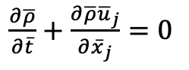
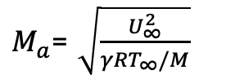
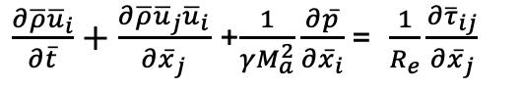
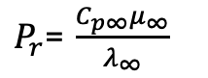
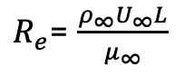
Dimensionless Form
Nondimensionalization is via a characteristic velocity and length scale
Note, as the Mach number approaches zero, the viscous work and kinetic energy terms become negligible
However, the momentum equation notes a singular due to the pressure gradient term
Conclusions: In the limit of zero Mach number, the momentum equation is not well defined and, in fact, singular
$\frac{∂\overline{ρ}}{∂\overline{t}}+\frac{∂\overline{ρ}{\overline{u}}_{j}}{∂{\overline{x}}_{j}}$ $=0$
$\frac{∂\overline{ρ}{\overline{u}}_{i}}{∂\overline{t}}+\frac{∂\overline{ρ}{\overline{u}}_{j}{\overline{u}}_{i}}{∂{\overline{x}}_{j}}$ +$\frac{1}{γM_{a}^{2}}\frac{∂\overline{p}}{∂{\overline{x}}_{i}}$= $\frac{1}{R_{e}}\frac{∂{\overline{τ}}_{ij}}{∂{\overline{x}}_{j}}$
$\frac{∂\overline{ρ}\overline{h}}{∂\overline{t}}+\frac{∂\overline{ρ}{\overline{u}}_{j}\overline{h}}{∂{\overline{x}}_{j}}$ = $−\frac{1}{{P_{r}R}_{e}}\frac{∂{\overline{q}}_{j}}{∂{\overline{x}}_{j}}+\frac{γ−1}{γ}\frac{∂\overline{p}}{∂\overline{t}}+\frac{γ−1}{γ}\frac{M_{a}^{2}}{R_{e}}\frac{∂{\overline{u}}_{i}{\overline{τ}}_{ij}}{∂{\overline{x}}_{j}}$ - $\frac{γ−1}{γ}$ $M_{a}^{2}\left(\frac{∂\overline{ρ}{\overline{u}}_{k}{\overline{u}}_{k}}{∂{\overline{x}}_{j}}+\frac{∂\overline{ρ}{\overline{u}}_{j}{\overline{u}}_{k}{\overline{u}}_{k}}{∂{\overline{x}}_{j}}\right)$
$R_{e}$= $\frac{ρ_{∞}U_{∞}L}{μ_{∞}}$
$P_{r}$= $\frac{C_{p∞}μ_{∞}}{λ_{∞}}$
$M_{a}$= $\sqrt{\frac{U_{∞}^{2}}{{γRT}_{∞}/M}}$

Slide 6
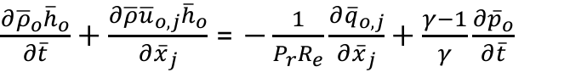
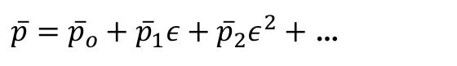
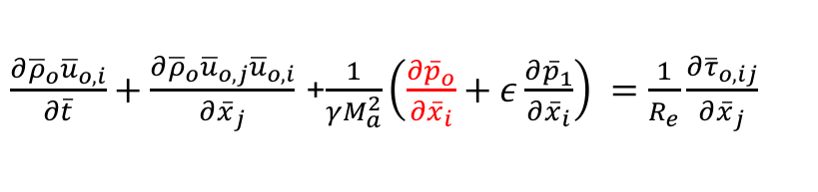
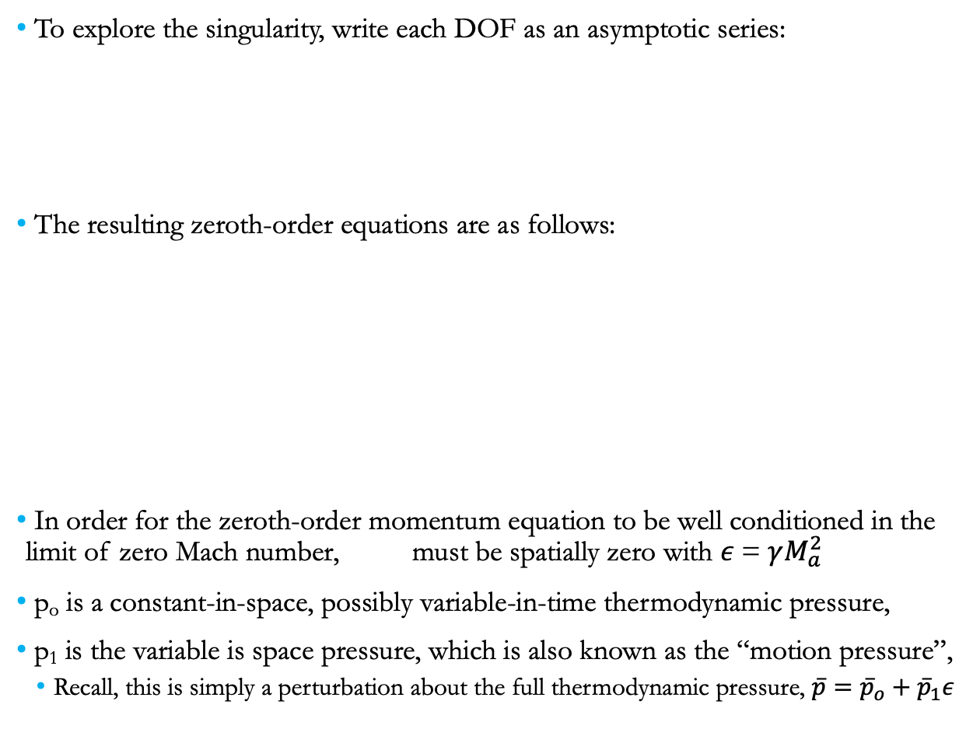
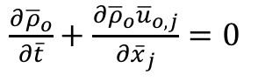
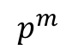
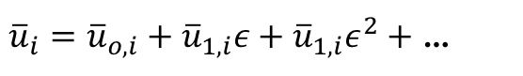
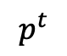
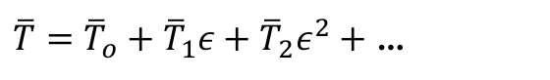
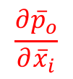
Exploration of the Pressure Singularity
To explore the singularity, write each DOF as an asymptotic series:
The resulting zeroth-order equations are as follows:
In order for the zeroth-order momentum equation to be well conditioned in the limit of zero Mach number, must be spatially zero with $ε$= $γM_{a}^{2}$
p_{o} is a constant-in-space, possibly variable-in-time thermodynamic pressure,
p₁ is the variable is space pressure, which is also known as the “motion pressure”,
Recall, this is simply a perturbation about the full thermodynamic pressure, $\overline{p}={\overline{p}}_{o}+{\overline{p}}_{1}ε$
$\overline{p}={\overline{p}}_{o}+{\overline{p}}_{1}ε+{\overline{p}}_{2}ε^{2}+$ …
${\overline{u}}_{i}={\overline{u}}_{o,i}+{\overline{u}}_{1,i}ε+{\overline{u}}_{1,i}ε^{2}+$ …
$\overline{T}={\overline{T}}_{o}+{\overline{T}}_{1}ε+{\overline{T}}_{2}ε^{2}+$ …
$\frac{∂{\overline{ρ}}_{o}}{∂\overline{t}}+\frac{∂{\overline{ρ}}_{o}{\overline{u}}_{o,j}}{∂{\overline{x}}_{j}}$ $=0$
Used in EOS/u_{i} eq
$\frac{∂{\overline{ρ}}_{o}{\overline{u}}_{o,i}}{∂\overline{t}}+\frac{∂{\overline{ρ}}_{o}{\overline{u}}_{o,j}{\overline{u}}_{o,i}}{∂{\overline{x}}_{j}}$ +$\frac{1}{γM_{a}^{2}}\left(\frac{∂{\overline{p}}_{o}}{∂{\overline{x}}_{i}}+ε\frac{∂{\overline{p}}_{1}}{∂{\overline{x}}_{i}}\right) =\frac{1}{R_{e}}\frac{∂{\overline{τ}}_{o,ij}}{∂{\overline{x}}_{j}}$
$\frac{∂{\overline{ρ}}_{o}{\overline{h}}_{o}}{∂\overline{t}}+\frac{∂\overline{ρ}{\overline{u}}_{o,j}{\overline{h}}_{o}}{∂{\overline{x}}_{j}}$ = $−\frac{1}{{P_{r}R}_{e}}\frac{∂{\overline{q}}_{o,j}}{∂{\overline{x}}_{j}}+\frac{γ−1}{γ}\frac{∂{\overline{p}}_{o}}{∂\overline{t}}$
$$\frac{∂{\overline{p}}_{o}}{∂{\overline{x}}_{i}}$$
$$p^{t}$$
$$p^{m}$$

Slide 7
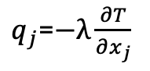
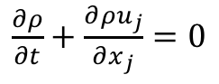
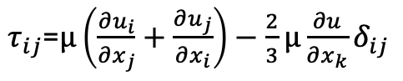
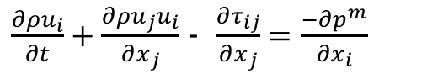
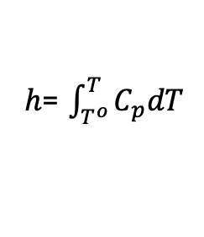
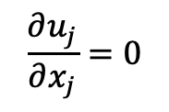
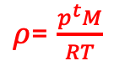
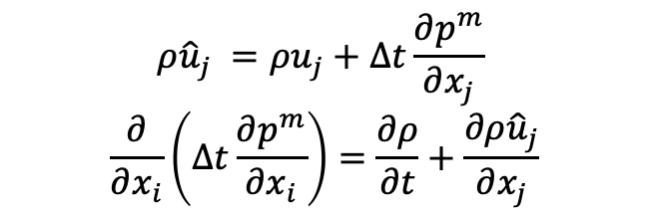
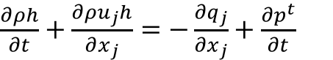
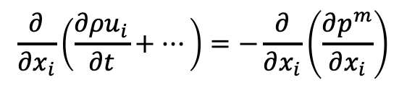
The Final low-Mach Number Equation Set
In dimensional form, the low-Mach system is as follows:
Energy transport is only required when the system modeled has a real temperature difference somehwre
EOS does not provide an equation for closure, some other approach is required for pressure!
In practice, a functional form for the motion pressure is derived where the continuity equation is enforced in some manner: divergence of momentum with commutation of time derivative
-
$\frac{∂ρ}{∂t}+\frac{∂{ρu}_{j}}{∂x_{j}}$ $=0$
$τ_{ij}$=$μ\left(\frac{∂u_{i}}{∂x_{j}}+\frac{∂u_{j}}{∂x_{i}}\right)−\frac{2}{3}μ\frac{∂u}{∂x_{k}}δ_{ij}$
$ρ$= $\frac{p^{t}M}{RT}$
$\frac{∂ρu_{i}}{∂t}+\frac{∂ρu_{j}u_{i}}{∂x_{j}}$ - $\frac{∂τ_{ij}}{∂x_{j}}=\frac{−∂p^{m}}{∂x_{i}}$
2+nDim
$\frac{∂ρh}{∂t}+\frac{∂ρu_{j}h}{∂x_{j}}$ $=−\frac{∂q_{j}}{∂x_{j}}+\frac{∂p^{t}}{∂t}$
$q_{j}$=$−λ\frac{∂T}{∂x_{j}}$
$h$= $\int_{T^{o}}^{T}{C_{p}dT}$
$$ρ{\hat{u}}_{j} =ρu_{j}+∆t\frac{∂p^{m}}{∂x_{j}}$$
$$\frac{∂}{∂x_{i}}\left(∆t\frac{∂p^{m}}{∂x_{i}}\right)=\frac{∂ρ}{∂t}+\frac{∂ρ{\hat{u}}_{j}}{∂x_{j}}$$
$$\frac{∂}{∂x_{i}}\left(\frac{∂ρu_{i}}{∂t}+…\right)=−\frac{∂}{∂x_{i}}\left(\frac{∂p^{m}}{∂x_{i}}\right)$$
Or….
$$\frac{∂u_{j}}{∂x_{j}}=0$$
;
Pressure Poisson Equation (PPE)

Slide 8
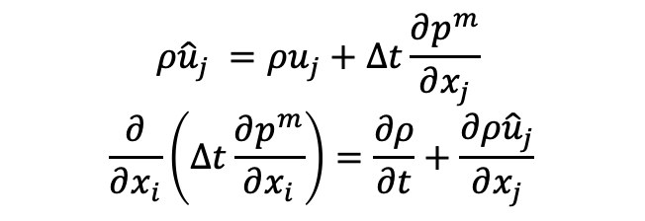
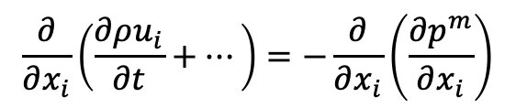
The Final low-Mach Number Equation Set: Ramifications
We have effectively filtered out the acoustics, i.e., the wave speed is infinitely fast
Continuity is met over any finite length instantly
DOF/Equation system is: ρ, p^{m}, u_{i}, h; p^{t} is a constant for an open domain
In practice, a functional form for the motion pressure is derived and known as a Pressure Poisson Equation (PPE)
Note that we have introduced an Elliptic nature of the equation set
Momentum and other equations can be implicit of explicitly solved, however, the Pressure Poisson Equation requires an implicit solve with dedicated solvers, e.g., multi-grid methods
$$ρ{\hat{u}}_{j} =ρu_{j}+∆t\frac{∂p^{m}}{∂x_{j}}$$
$$\frac{∂}{∂x_{i}}\left(∆t\frac{∂p^{m}}{∂x_{i}}\right)=\frac{∂ρ}{∂t}+\frac{∂ρ{\hat{u}}_{j}}{∂x_{j}}$$
$$\frac{∂}{∂x_{i}}\left(\frac{∂ρu_{i}}{∂t}+…\right)=−\frac{∂}{∂x_{i}}\left(\frac{∂p^{m}}{∂x_{i}}\right)$$
Pressure Poisson Equation (PPE)

Slide 9
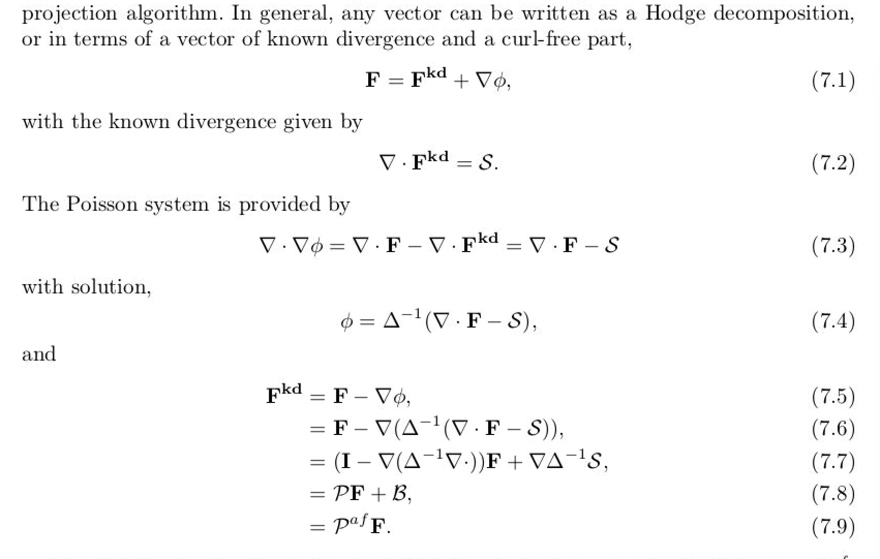
Why ”pressure projection”?
From Domino, 2006 “﻿Toward verification of formal time accuracy for a family of approximate projection methods using the method of manufactured solutions”
For a solenoidal vector, div(u) is zero and P is an “idempotent” projection, i.e., P=P²
Otherwise, P is an affine-projection operator

Slide 10
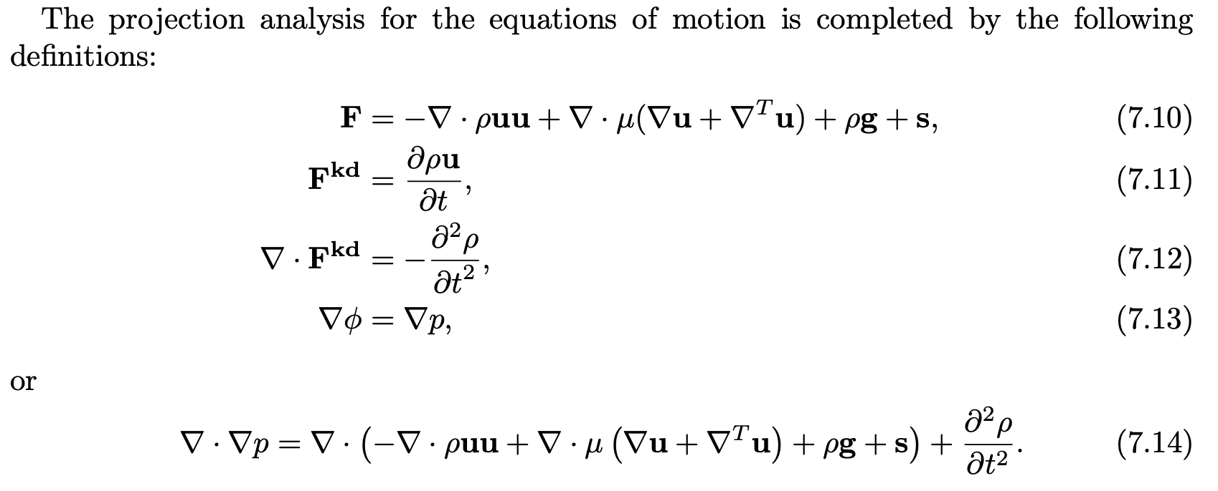
Formal Projection Applied to low-Mach system
From Domino, 2006 “﻿Toward verification of formal time accuracy for a family of approximate projection methods using the method of manufactured solutions”

Slide 11

Thought Experiment…
Large domain, one door, one “exit”
Maples Pavilion

Slide 12
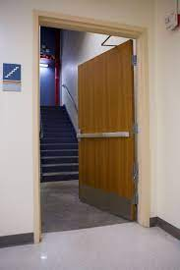
Thought Experiment…
Large domain, one door, one “exit”

Slide 13
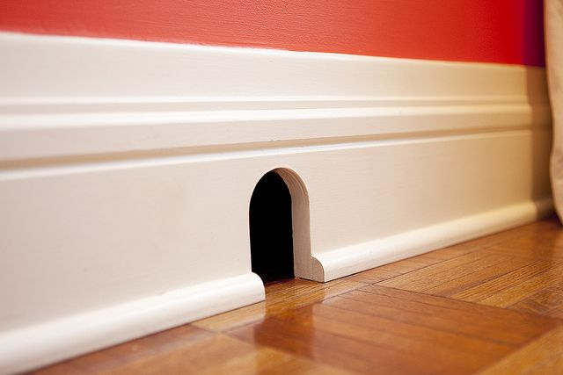
Thought Experiment…
Large domain, one door, one “exit”

Slide 14
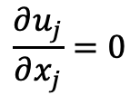
Thought Experiment…
Large domain, one door, one “exit”
Walls
$$\frac{∂u_{j}}{∂x_{j}}=0$$
Inflow
Outflow
Walls

Slide 15
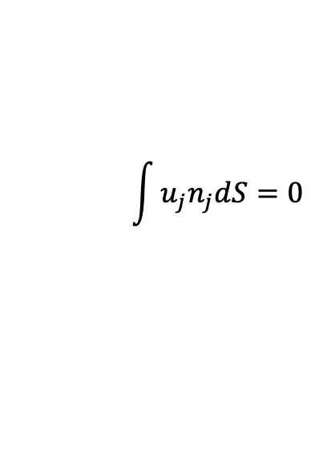
Thought Experiment…
Large domain, one door, one “exit”
Walls
$$\frac{∂u_{j}}{∂x_{j}}=0$$
$$\int{u_{j}n_{j}dS}=0$$
Inflow
Out – In = 0 (at t = to+0.0000000001
Outflow
Walls

Slide 16
Thought Experiment… Solver Ramifications….
Fixed point solvers iterate over the domain sequentially and are effective when this sweeping of the mesh corresponds to a particular physical direction
Walls
Sweeping direction
Inflow
Outflow
Walls

Slide 17
Thought Experiment… Elliptic Solver Ramifications….
For Elliptic systems, fixed point iterative solvers fail since the sequential propagation of information is not adequate for a system with infinite wave speeds
Walls
Inflow
All locations are strongly coupled
Outflow
Walls

Slide 18
Thought Experiment… Elliptic Solver Ramifications….
Multigrid methods (MG) are essential for efficient solver performance in fluids-based Elliptic systems
In simple, structured domains, this can be geometric (GMG), while in unstructured, algebraic (AMG)

Slide 19
Introduction to the low-Mach Number Approximation: Conclusions
Variable density, non-isothermal equation set allow for all length and time scales for a given physics
The non-dimensional form of the momentum equation is singular in the limit as Mach number approaches zero
low-Mach equations are derived by nondimensionalization and asymptotic expansion
For a low-Mach flow, the density and thermodynamic pressure are not strongly coupled by an equation of state, hence, stiffness arises as Ma->0
The constant-in-space thermodynamic pressure is used in the EOS
The low-Mach procedure filters the acoustics, which can not be of prime interest in the flow

